Slide 1
Genesis of Enterprise Computing using Full stack
Agenda
Disruptive Technology
Digital Transformation
IT Full stack Development(Generalist )
Full Stacks
Java Full stack
Java Script based Full Stack
Java Vs. Java Script
Java Stack vs. Java Script Full stack
Core Java vs. Advanced Java

Slide 2
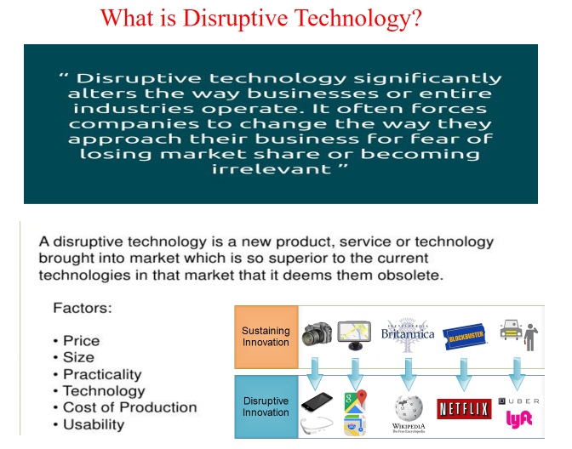

Slide 3
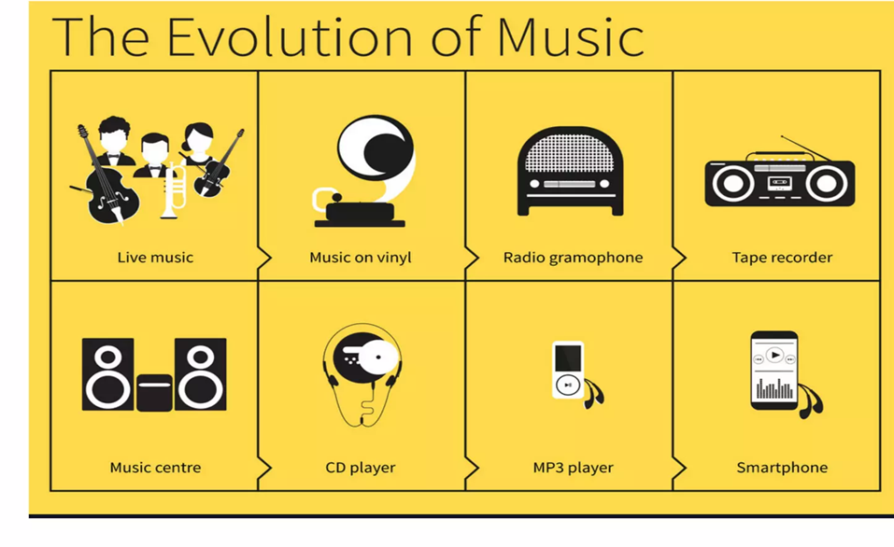

Slide 4
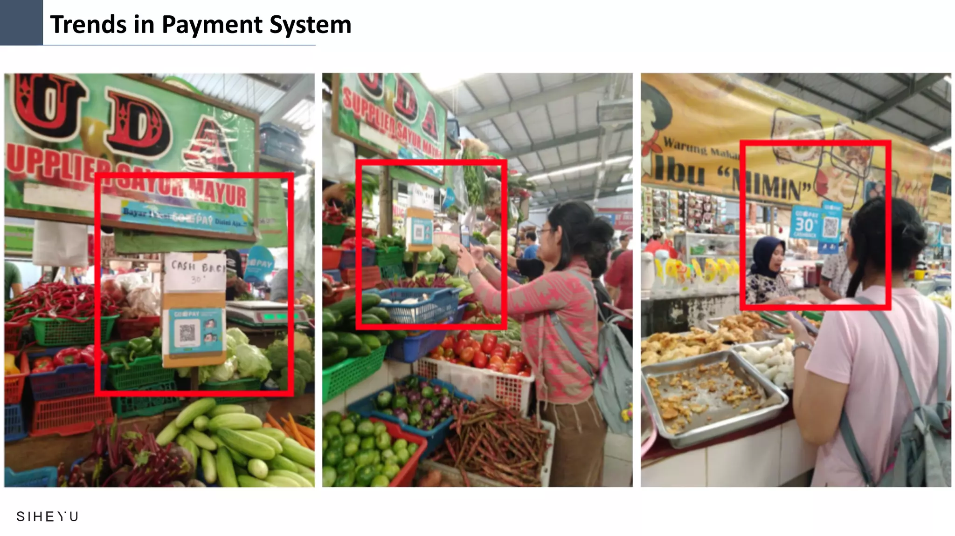
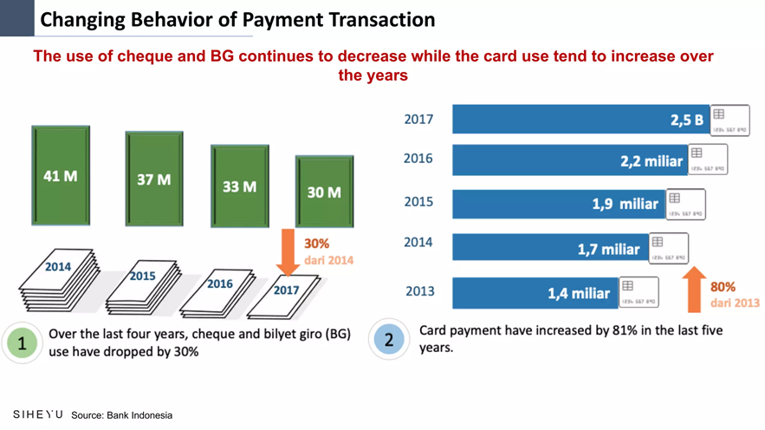

Slide 5
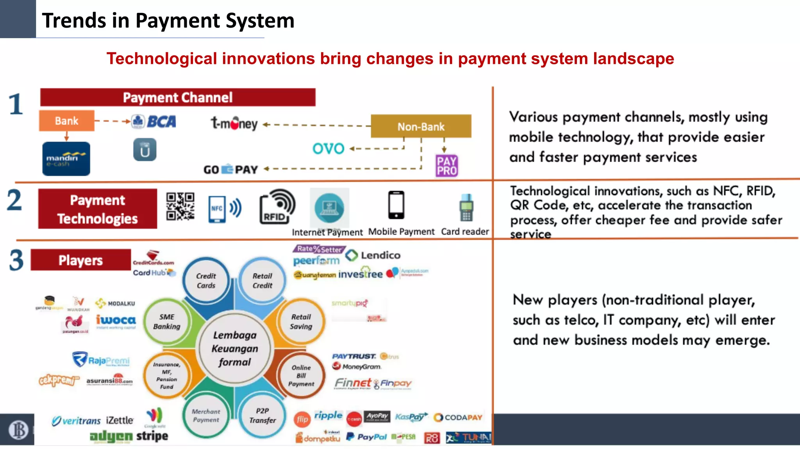

Slide 6
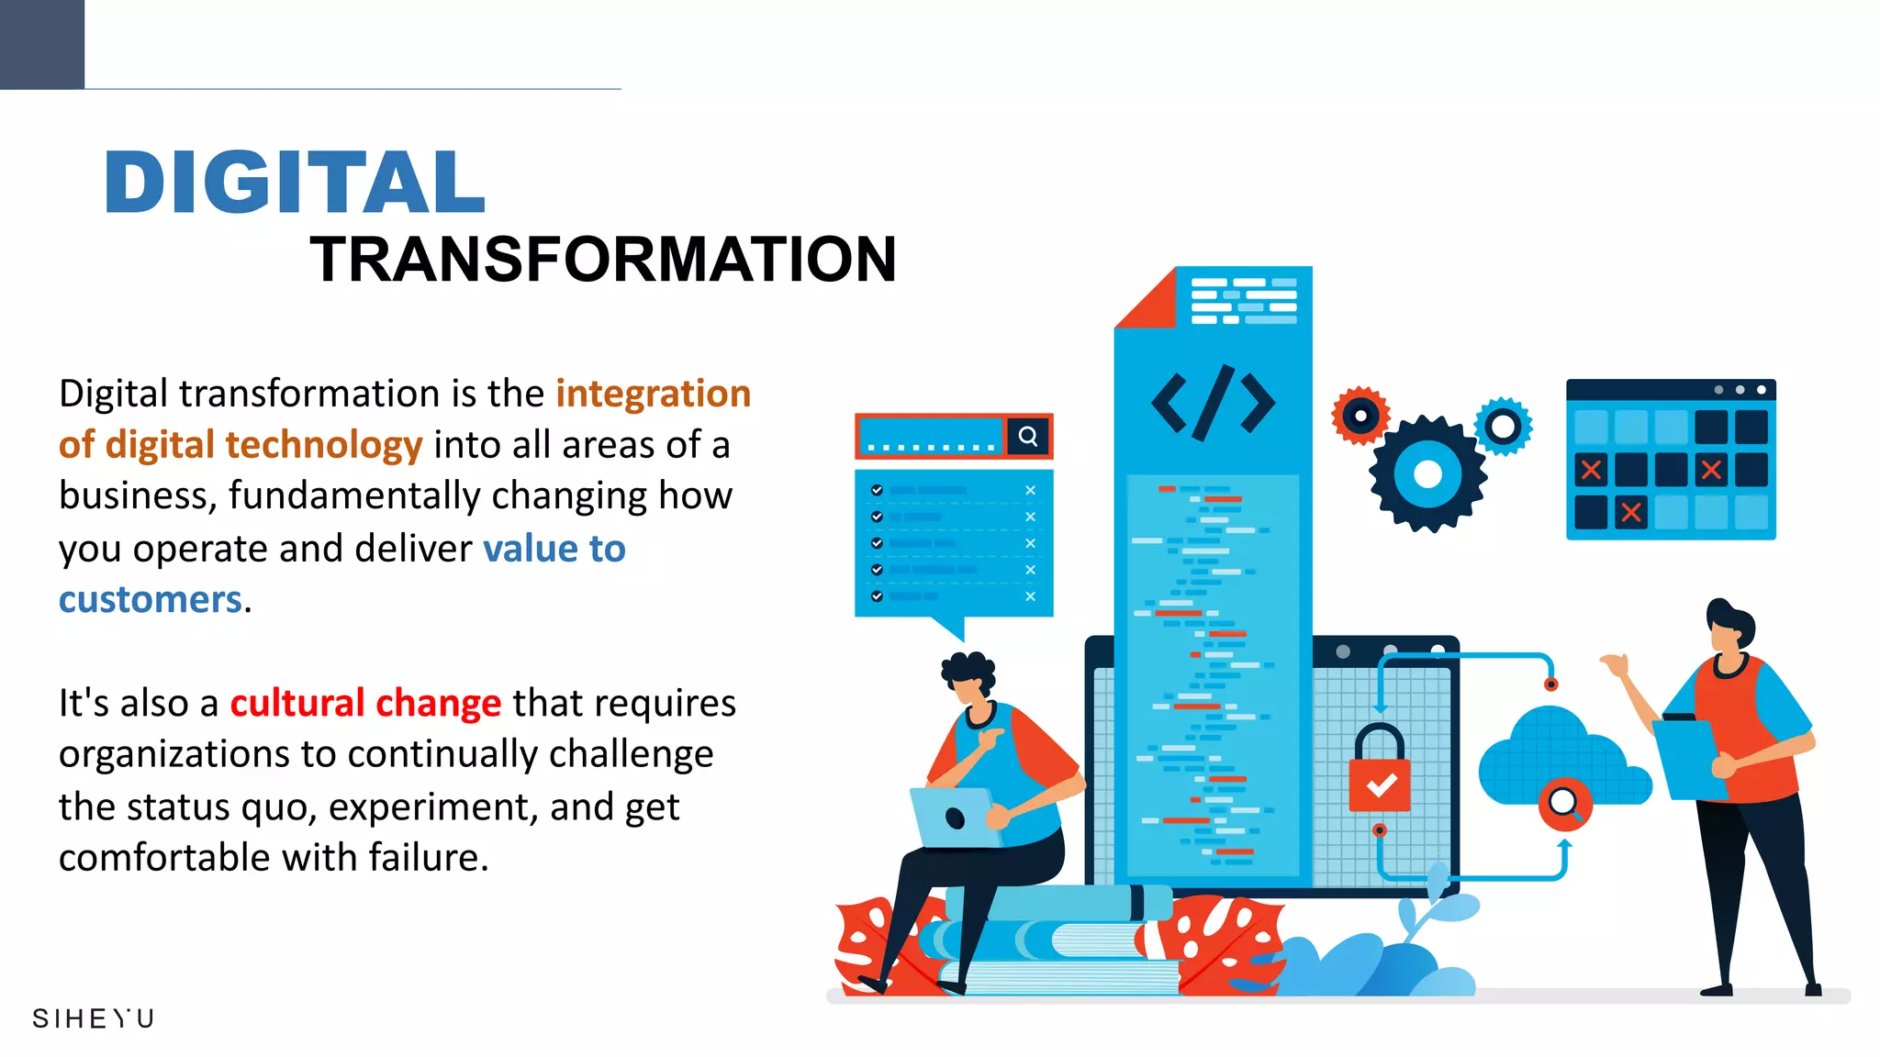
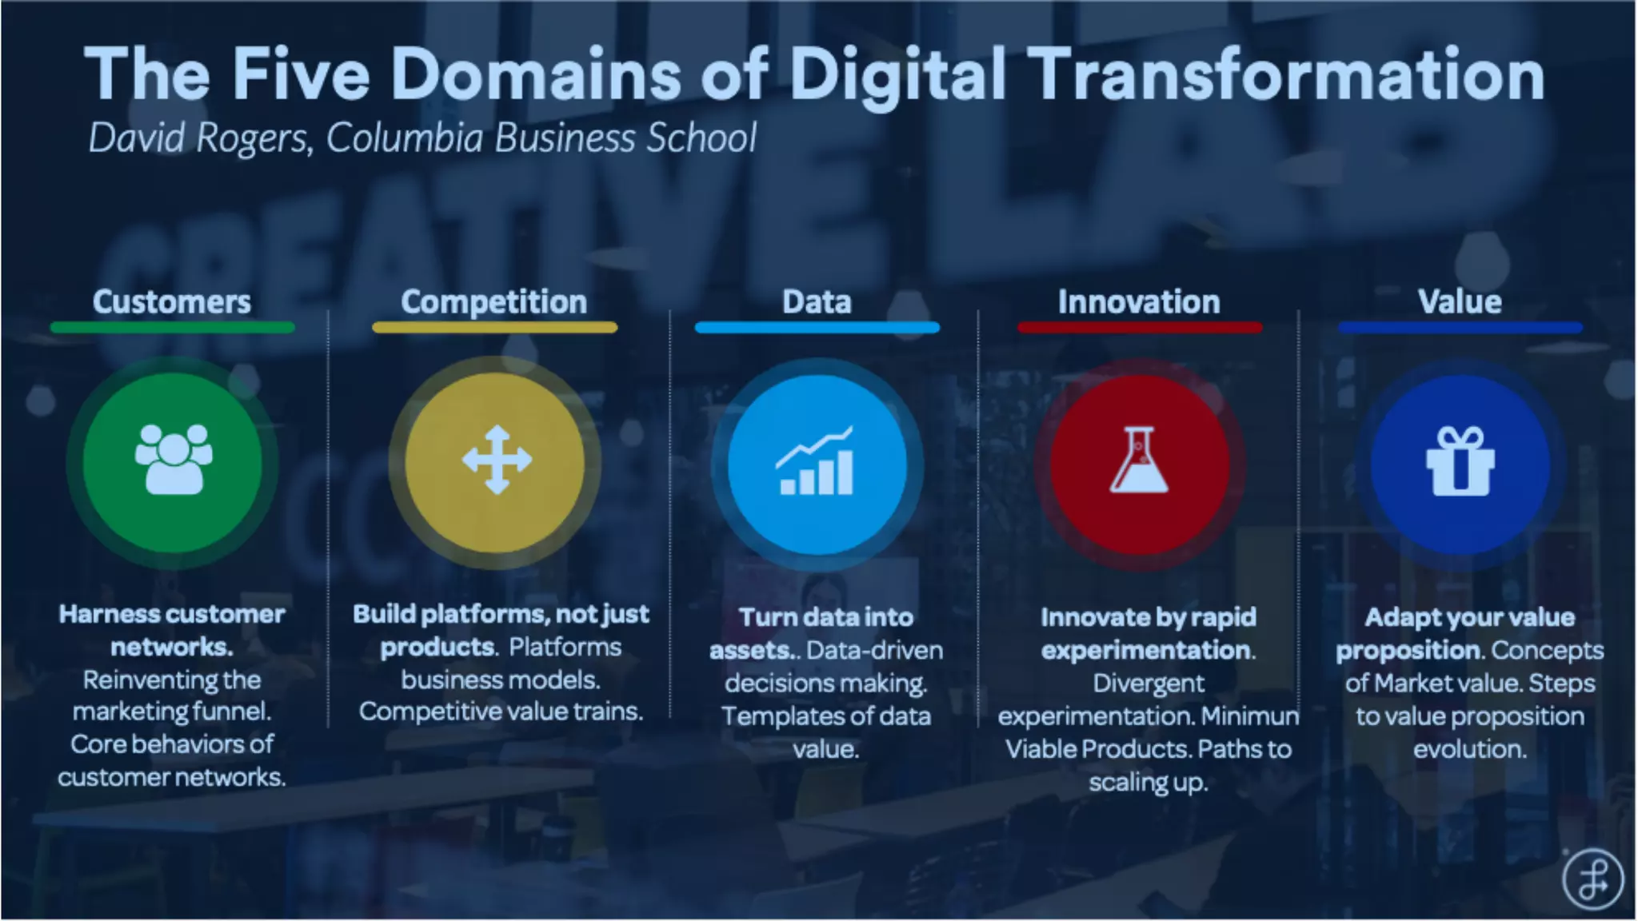

Slide 7
What Is Digital Transformation?
Digital transformation as the integration of digital technology into all areas of a business resulting in fundamental changes to how businesses operate and how they deliver value to customers.
Digital transformation is the process of using technology to create new ways of doing business. i.e. The concept can comprise changing existing systems or building new ones.
Company culture, business processes, and customer experience can all be upgraded by digital transformation.
Digital transformation is a continuous process of adapting, changing, and improving over time, so it’s important for everyone within the organization to be on board.
By implementing digital transformation, businesses can keep up with changing demands within their market and the business world at large.
Beyond that, it's a cultural change that requires organizations to continually challenge the status quo, experiment often, and get comfortable with failure.
This sometimes means walking away from long-standing business processes that companies were built upon in favor of relatively new practices that are still being defined

Slide 8
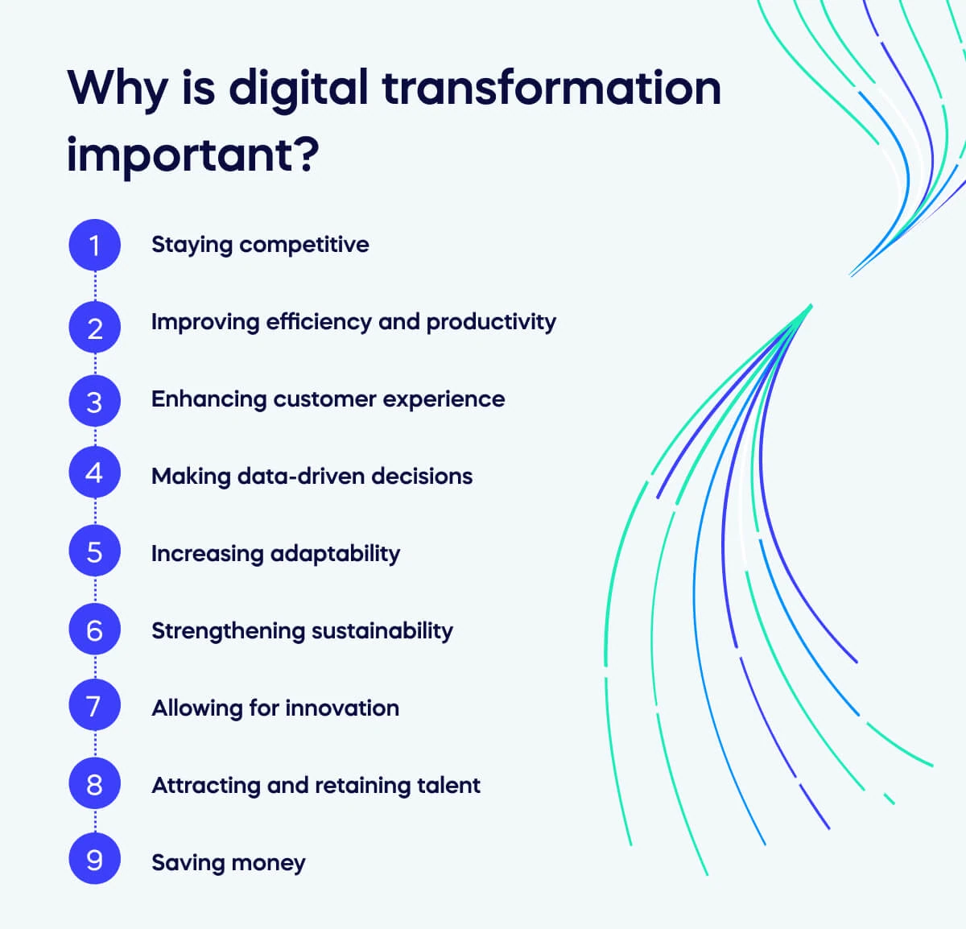

Slide 9
Staying competitive – Businesses that do not embrace digital transformation risk falling behind their competitors, who have upgraded their tools and processes to become more efficient and effective.
Improving efficiency and productivity – Digital transformation streamlines processes, automates tasks, improves data management, frees time for employees to focus on other business areas, and improves productivity.
Enhancing customer experience – Companies can offer online services, personalized interactions, quick responses to queries, and a more seamless experience, which means digital transformation is vital for customer experience.
Making data-driven decisions – Organizations can collect and analyze digital transformation data at scale, using it to understand customer behavior and preferences. They can then make informed decisions to create products and services that better meet customer needs.
Increasing adaptability – Digital transformation allows companies to keep up with changing market conditions and customer demands. They have enhanced capabilities for taking a consistently responsive and flexible approach.
Strengthening sustainability – With digitized processes in place, companies can reduce their energy consumption and paper waste, allowing them to take an environmentally friendly and sustainable approach to their business.
Allowing for innovation – By implementing digital transformation processes, companies can explore new business models, develop new products or services, or enter new markets.
Attracting and retaining talent – Creating a technologically advanced company means that younger generations entering the workforce are more likely to apply. Companies with digital transformation strategies are likely to attract and retain top talent.
Saving money – Digital processes reduce the need for physical resources, manual labor, and paperwork, significantly reducing costs in the long run.

Slide 10
How does digital transformation work?
No two businesses are identical, so digital transformation processes are not one-size-fits-all. A company’s approach depends on its needs, goals, and structure.
Many examples of enterprises have undergone successful digital transformation, but here are some ways such a change can be carried out within specific organizations.
A government agency may digitize its records and implement an online platform to streamline citizen services such as paying taxes or renewing licenses.
An educational company may shift traditional classroom learning to online platforms, increasing their audience reach and providing flexible learning opportunities.
A furniture store may create virtual showrooms with 360-degree views of products or online design tools to help customers visualize and plan their interior spaces.
A glasses company may allow customers to try on their products by letting them upload a photo of themselves to the website.
An e-commerce store may use AI algorithms to analyze customer behavior and preferences, subsequently offering personalized recommendations based on previous purchases and browsing history.

Slide 11
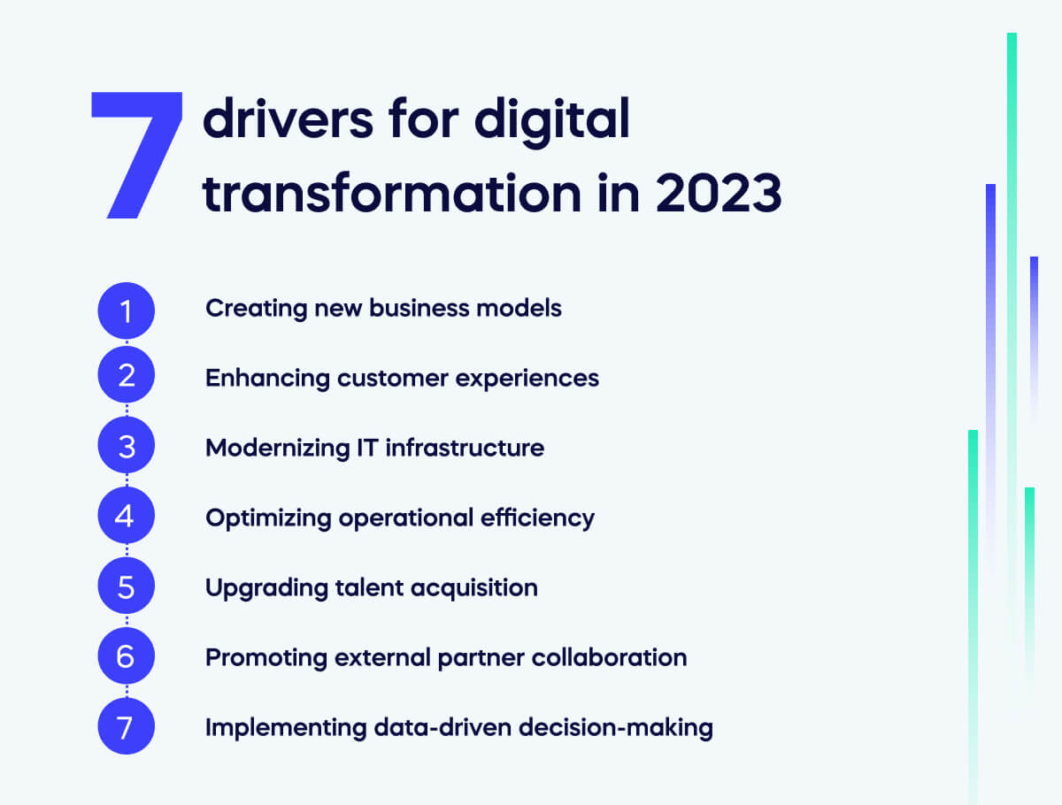
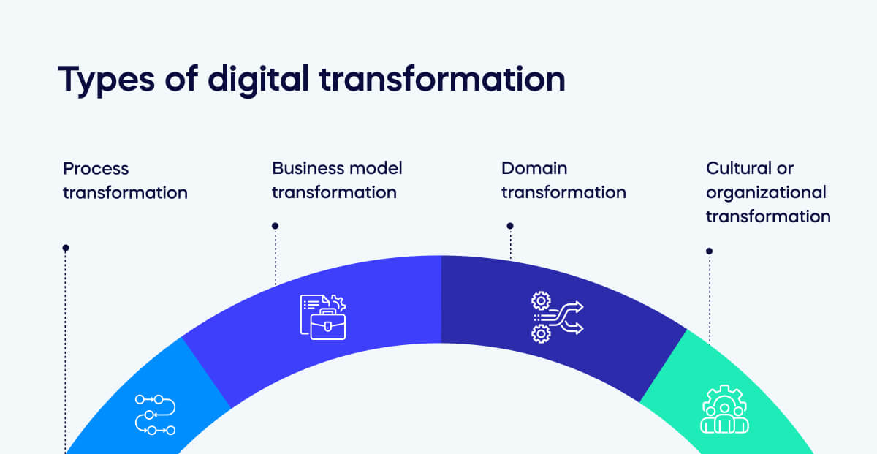

Slide 12
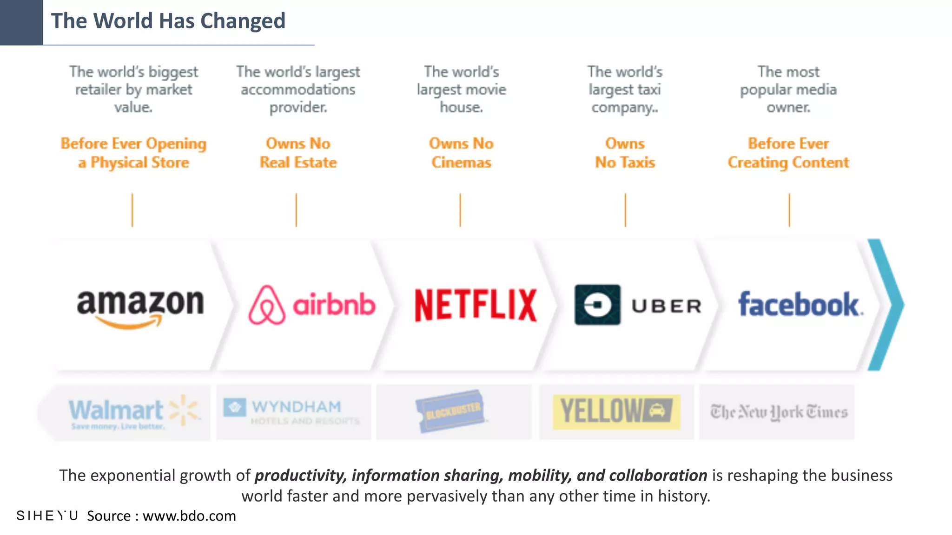

Slide 13
Full stack Developer
IT Specialists vs. IT Generalists

Slide 14

It’s the age-old debate- do you want to be the best all-around employee or the one with the exact strengths needed to be the best for a particular task? That is the question posed in the generalist vs. specialist debate.
To begin this discussion, one must first understand what it means to be generalist as opposed to a specialist. Dictionary.com defines a generalist as a person whose knowledge, aptitudes, and skills are applied to a field as a whole or to a variety of different fields; as opposed to a specialist who is defined as a person who devotes himself or herself to one subject or to one particular branch of a subject or pursuit.
In today’s changing job landscape does it pay to be a generalist or a specialist?

Slide 15
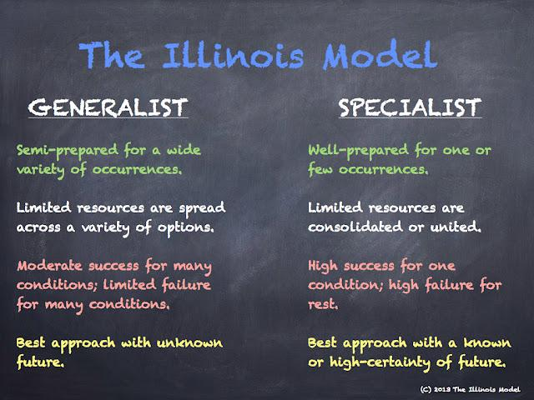


Slide 16
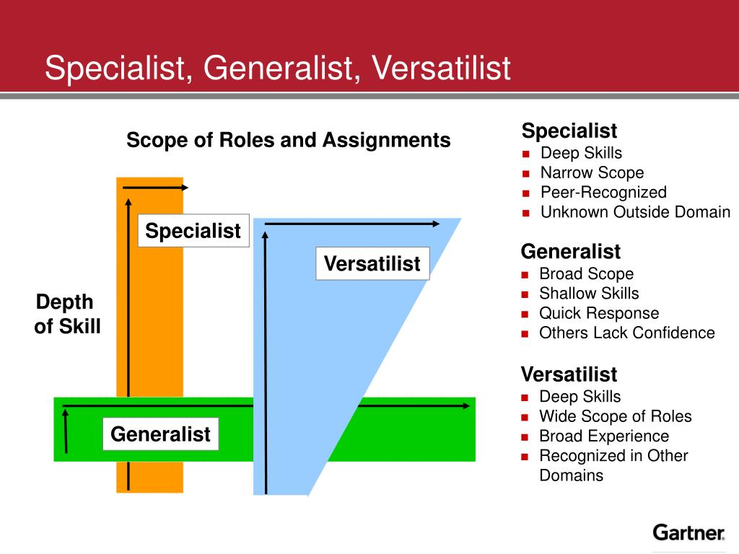
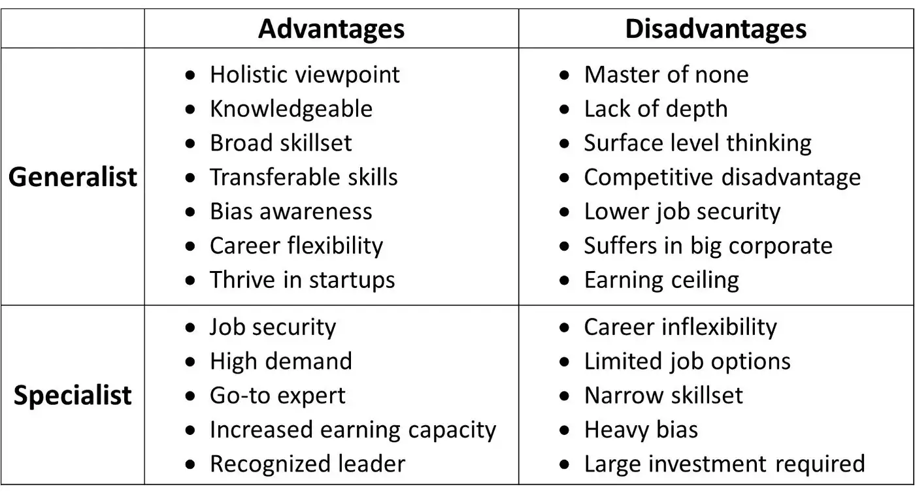

Slide 17
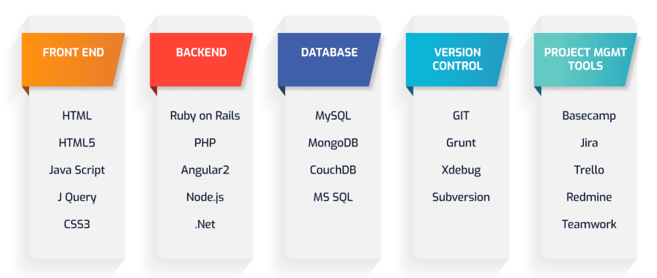
The pros and cons of a generalist
A generalist - someone who has a range of skills and knowledge. In order to be a capable generalist, one must have experience with various subjects over an extended period of time.
In the world of web development, a full-stack developer can be seen as a generalist.
If you can be efficient in contributing to the frontend, backend, databases, and also ship the project using various dev-ops tools, then you can call yourself a full-stack developer(that said, there's no clear definition for that). But not only - as a jack of all trades, you should also be able to manage projects, talk to clients, etc.
Some of the good things about being a generalist include
Being able to solve problems in various subjects
An ability to see the bigger picture
A smaller chance of becoming obsolete, as your skills are useful in different situations
Variety
The negative parts of being a generalist include
There are smaller limits to the depth of your knowledge
It's easier to replace you when problems get specific
A constant need to keep yourself up-to-date with various topics

Slide 18
The pros and cons of a specialist – Front-End Developer or Back –End Developer
A specialist is someone who's got lots of experience, knowledge, or skill in a particular subject. In order to gain that kind of mastery, one must do focused work for a long period of time, giving attention only to a limited range of subjects.
Some good things about being of a specialist include
Ability to contribute to solving complex problems
Possibility to become an expert in a specific domain
Less competition
More money
The negative parts about specializing include:
Less variety in the problems you're able to solve
Bigger chance of becoming obsolete
A danger of having a narrow view of things

Slide 19
What is an Enterprise Application?
An enterprise application is a large, complex software system used by organizations to support business operations. Examples include HRMS, inventory management systems, and customer service software. These applications are designed to improve productivity, increase efficiency, and provide data-driven insights to inform decision-making.
Enterprise applications are designed to integrate computer systems that run all phases of an enterprise’s operations to facilitate cooperation and coordination of work across the enterprise.
The intent is to integrate core business processes (e.g., sales, accounting, finance, human resources, inventory and manufacturing).
The ideal enterprise system could control all major business processes in real time via a single software architecture on a client/server platform. Enterprise software is expanding its scope to link the enterprise with suppliers, business partners and customers.
What is Enterprise Application Development?
The process of building and deploying a scalable solution for large-scale firms to accommodate their needs is known as enterprise application development.
It addresses the pain points suffered by the firm and enables effective engagement of clients, employees, and partners.
Through enterprise applications, the workflow gets automated, which empowers users to accomplish tasks in lesser time than usual.
Agility, speed, and scalability are crucial points to consider while developing the application.
Cloud technologies facilitate the adoption of developing enterprise applications.

Slide 20
What is Full-Stack Development?
The technique of designing and creating all levels of a web application, including the frontend, backend, and database, is referred to as full-stack development.
A full-stack developer is knowledgeable in both frontend and backend technologies and is capable of creating a comprehensive web application from the ground up.
Why Full-Stack Development is Important in 2026?
Full-stack development is now required for producing high-performance, responsive, and scalable online apps in 2026.
Companies want developers that can work across many technology stacks and produce end-to-end solutions.
Full-stack developers can assist shorten a project's development cycle while preserving code quality.

Slide 21
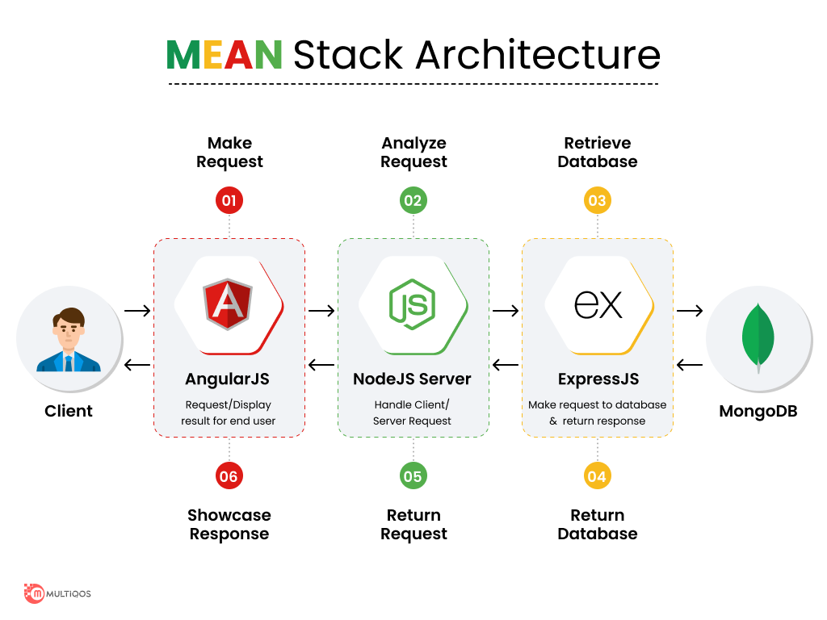

Slide 22
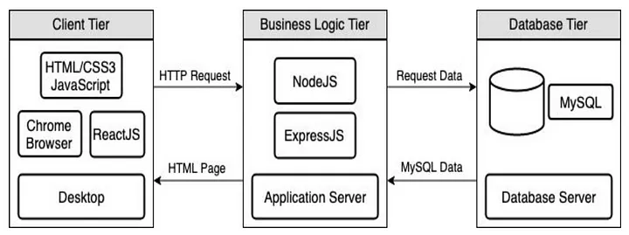

Slide 23
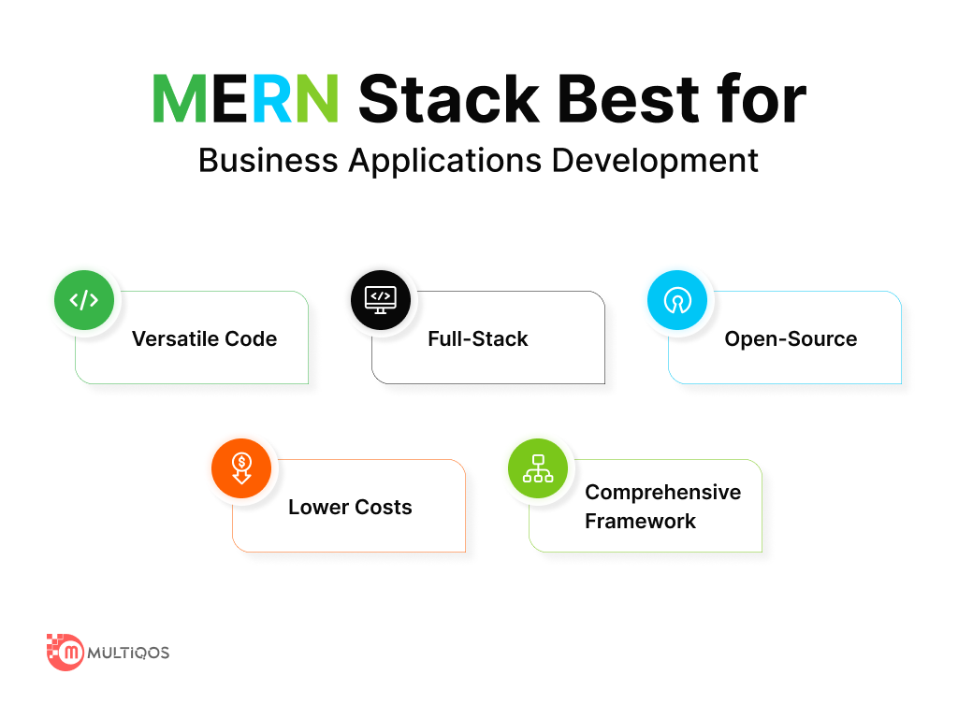

Slide 24
Enterprise computing and full-stack development are two concepts that are related but represent different aspects of the software development and IT landscape.
Enterprise Computing:
Enterprise computing refers to the use of information technology (IT) in organizations, particularly large businesses or enterprises. It involves the design, deployment, and management of complex computing environments that support the various needs of an organization.
This includes infrastructure, software applications, data management, security, networking, and more. The goal of enterprise computing is to streamline business processes, improve efficiency, and support the overall goals of the organization.
Enterprise computing often involves the use of large-scale systems, databases, and applications that can handle a significant amount of data and user interactions.
It also encompasses areas such as enterprise resource planning (ERP), customer relationship management (CRM), and other business-critical systems.
Full-Stack Development:
Full-stack development refers to the practice of working on both the front-end (client-side) and back-end (server-side) of an application or system.
A full-stack developer is someone who has expertise in both the user interface (UI) and user experience (UX) aspects of an application as well as the server-side logic, databases, and other components that make the application function.
A full-stack developer is typically proficient in multiple technologies and languages, allowing them to work on various layers of a software stack.
The software stack consists of the technology layers that make up an application, from the user interface to the database and everything in between.

Slide 25
Relation between Enterprise Computing and Full Stack:
The relationship between enterprise computing and full-stack development lies in the context of building and maintaining enterprise-level applications.
In large organizations, full-stack developers may be involved in creating and maintaining various components of enterprise systems.
These systems often require a combination of front-end and back-end development skills to deliver a cohesive and integrated solution.
Full-stack developers working in an enterprise environment may contribute to the development of user interfaces, business logic, integration with databases, and other essential components of enterprise applications.
Their expertise allows them to understand and work across different layers of the technology stack, ensuring that the entire system functions seamlessly.
In summary, while enterprise computing focuses on the broader use of IT in organizations, full-stack development plays a role in the implementation and maintenance of the software and systems that form a part of enterprise computing.
Full-stack developers bring a comprehensive skill set to the table, making them valuable contributors to the development and evolution of enterprise-level

Slide 26
Studying the course "Enterprise Computing using Full Stack" can offer several benefits and is relevant for individuals pursuing careers in software development, especially in the context of large-scale business applications. Here are some reasons why studying this course might be valuable:
Comprehensive Skill Set: Full-stack development involves working on both the front-end and back-end of applications. Understanding the full stack equips you with a comprehensive skill set, allowing you to work on various components of an application, from user interfaces to server-side logic and databases.
Versatility: Full-stack developers are versatile and can contribute to different parts of a project. This versatility is valuable in dynamic development environments where individuals may need to switch between tasks or collaborate with different teams.
Holistic Understanding: Enterprise computing often involves complex systems with multiple layers. Studying full-stack development provides a holistic understanding of how different parts of a system interact, allowing you to design and implement solutions that consider the entire technology stack.
Efficient Problem Solving: Full-stack developers are well-equipped to troubleshoot issues and solve problems across the entire application. This efficiency is crucial in enterprise environments where quick and effective problem resolution is essential for maintaining business continuity.
Collaboration and Communication: Full-stack developers can bridge the gap between front-end and back-end teams, facilitating better collaboration and communication in a development project. This is especially important in large enterprises where cross-functional teams are common.

Slide 27
Adaptability to Technologies: Technology landscapes evolve, and the ability to adapt to new technologies is crucial. Full-stack development exposes you to a variety of tools, frameworks, and languages, making it easier to learn and adopt new technologies as they emerge.
Career Opportunities: Many enterprises seek professionals with full-stack development skills because they can contribute to various aspects of a project. This can open up a broader range of career opportunities, especially in organizations that value versatile and skilled developers.
Agile Development: Full-stack development aligns well with agile development methodologies. Agile emphasizes collaboration, adaptability, and the ability to deliver functional software quickly, qualities that are inherent in the full-stack development approach.
Entrepreneurial Ventures: If you aspire to work on your entrepreneurial projects or start a tech-related business, having full-stack development skills can be advantageous. It allows you to handle the development process from end to end, creating a more self-reliant approach.
Demand in the Job Market: There is a growing demand for full-stack developers in the job market. Many organizations value professionals who can contribute to different parts of the development process, making full-stack developers sought after.
In conclusion, studying "Enterprise Computing using Full Stack" provides a well-rounded education that prepares individuals to tackle the challenges of building and maintaining complex enterprise applications. It combines technical proficiency with a broad understanding of system architecture, making graduates valuable contributors in the rapidly evolving field of enterprise computing.

Slide 28
The terms "Java full stack" and "JavaScript full stack" refer to different technology stacks that are commonly used in full-stack development. Both have their strengths and use cases, and the choice between them often depends on various factors such as project requirements, team expertise, and specific goals. Let's explore each of them:
Java Full Stack:
In a Java full-stack development environment, the primary programming language used for both the front-end and back-end development is Java. Here's a breakdown of the typical components in a Java full stack:
Front-end (Client-Side): JavaServer Faces (JSF), Thymeleaf, or other Java-based templating engines can be used for building the user interface.
Back-end (Server-Side): Java-based frameworks like Spring or Java EE (Enterprise Edition) are commonly used for server-side development. These frameworks provide tools and libraries for building robust and scalable applications.
Database: Java applications often interact with relational databases using technologies like Java Database Connectivity (JDBC). Object-relational mapping (ORM) frameworks such as Hibernate may also be used.
Middleware: Java applications might use middleware technologies like Apache Tomcat or other application servers to deploy and run applications.

Slide 29
JavaScript Full Stack:
In a JavaScript full-stack development environment, JavaScript is the primary programming language used for both front-end and back-end development. Here's a breakdown of the typical components in a JavaScript full stack:
Front-end (Client-Side): JavaScript is used along with HTML and CSS to build interactive and dynamic user interfaces. Popular front-end frameworks/libraries include React, Angular, or Vue.js.
Back-end (Server-Side): JavaScript is used for server-side development with the help of Node.js. Express.js is a popular web application framework for building server-side applications with Node.js.
Database: JavaScript applications can interact with various databases, both SQL and NoSQL. MongoDB, a NoSQL database, is commonly used in JavaScript full-stack development.
Middleware: Node.js itself serves as middleware in JavaScript full-stack applications. It allows developers to build scalable network applications and handle concurrent connections.

Slide 30
Considerations which Full Stack :
Language Consistency: If consistency in programming language is a priority, Java full stack might be preferred since it uses Java for both front-end and back-end. In contrast, JavaScript full stack uses JavaScript on both ends.
Ecosystem and Frameworks: Consider the ecosystems and frameworks associated with each stack. Java has a long-established ecosystem with frameworks like Spring, while JavaScript has a dynamic ecosystem with Node.js and various front-end frameworks.
Community and Support: Both Java and JavaScript have large and active communities. Consider the community support, resources, and third-party libraries available for each stack.
Scalability and Performance: Both stacks can be used to build scalable and high-performance applications. Consider specific requirements and benchmarks for your project.
Ultimately, the choice between Java full stack and JavaScript full stack depends on your team's expertise, project requirements, and other factors specific to your development environment.

Slide 31
Comparing Java Full Stack and JavaScript Full Stack involves looking at the languages, frameworks, ecosystems, and typical development stacks associated with each. Both Java and JavaScript are versatile and widely used in full-stack development, but they have some differences in terms of technology stacks and approaches. Here's a comparison between Java Full Stack and JavaScript Full Stack:
Java Full Stack:
Backend:
Language: Java
Frameworks: Spring (Spring Boot, Spring MVC), JavaServer Faces (JSF), Play Framework
Database: JDBC, Hibernate (ORM)
Build Tools: Maven, Gradle
Server: Apache Tomcat, Jetty
Frontend:
Languages: HTML, CSS, JavaScript (often with Java-generated content)
Frameworks: JavaServer Faces (JSF) for server-side rendering, Thymeleaf
AJAX Libraries: jQuery
Build Tools: Maven, Gradle
Full-Stack Frameworks:
Spring Boot: A popular choice for building Java-based microservices and web applications.
Play Framework: A reactive web application framework for Java and Scala.

Slide 32
Java based enterprise applications are synonymous with renowned multinationals, including Amazon, Oracle, and IBM. Other organizations that run their day-to-day business operations on systems built by Java include:
Microsoft: the company has been leveraging Java for decades to build server-side applications, a good example being the Azure cloud platform.
PayPal: the global payment solution, uses Java for various needs, including the development of payment processing system, fraud detection system, and other key services.
Netflix: Netflix’s entire streaming platform is built on Java. They use Java to develop the backend services powering the streaming platform.
Uber: Uber, the ride-hailing giant, uses Java for developing their backend services. They use Java to build their payment system, surge pricing algorithm, and other critical services.
Salesforce: Salesforce offers cloud-based customer relationship management (CRM) software as a service. Java is the main framework behind the platform’s database, security features, and other client-facing functionalities.
Airbnb: Airbnb’s backend services are powered by Java, including a surge pricing algorithm, payment system, and messaging.

Slide 33
JavaScript Full Stack:
Backend:
Language: JavaScript (Node.js)
Frameworks: Express.js, Nest.js, Koa.js
Database: MongoDB (NoSQL), PostgreSQL (SQL)
Build Tools: npm, Yarn
Server: Express.js, Hapi.js
Frontend:
Languages: HTML, CSS, JavaScript (ES6+)
Frameworks: React, Angular, Vue.js
AJAX Libraries: Axios, Fetch API
Build Tools: Webpack, Babel
Full-Stack Frameworks:
MEAN Stack (MongoDB, Express.js, Angular, Node.js): A popular JavaScript-based full-stack solution.
MERN Stack (MongoDB, Express.js, React, Node.js): Another variant with React as the frontend library.

Slide 34
Comparison Java Full Stack vs. Java Script Full stack:
Language Consistency:
Java Full Stack: Consistent use of Java throughout the stack.
JavaScript Full Stack: Use of JavaScript both on the frontend and, with Node.js, on the backend.
Ecosystem and Libraries:
Java Full Stack: Rich ecosystem with a wide range of libraries and frameworks, especially in enterprise settings.
JavaScript Full Stack: Large and vibrant ecosystem with a focus on web development. Extensive npm package registry.
Frameworks:
Java Full Stack: Spring Boot is widely used for building robust and scalable applications.
JavaScript Full Stack: Various frameworks like Express.js (Node.js) and React, Angular, or Vue.js for the frontend.
Database Connectivity:
Java Full Stack: Typically uses relational databases with JDBC or Hibernate for ORM.
JavaScript Full Stack: Often uses NoSQL databases like MongoDB, especially in conjunction with Node.js.
Build Tools:
Java Full Stack: Maven and Gradle are popular build tools.
JavaScript Full Stack: npm and Yarn are common for managing dependencies and running scripts.
on may be influenced by the specific needs of a given project or organization.

Slide 35
Server:
Java Full Stack: Apache Tomcat and Jetty are popular servers.
JavaScript Full Stack: Node.js serves as a server on the backend.
Concurrency and Scaling:
Java Full Stack: Java is known for its robust support for concurrency, making it suitable for large-scale applications.
JavaScript Full Stack: Node.js is designed for handling a large number of simultaneous connections.
Community and Job Market:
Java Full Stack: Established in enterprise environments with a large community. Many job opportunities.
JavaScript Full Stack: Extremely popular in web development, especially in startups and smaller teams. High demand for developers.
In summary, the choice between Java Full Stack and JavaScript Full Stack often depends on factors such as existing infrastructure, team expertise, project requirements, and personal preferences.
Both stacks are capable of building powerful and scalable applications, and decision may be influenced by the specific needs of a given project or organization.

Slide 36
List possible full stack technology for enterprise computing
For enterprise computing, where the development of large-scale, mission-critical applications is common, a full-stack technology stack should be robust, scalable, and capable of handling complex business requirements. Here is a list of possible full-stack technologies suitable for enterprise computing:
Backend Technologies:
Java Full Stack:
Backend Language: Java
Frameworks: Spring Boot, Java EE, Play Framework
Database: MySQL, PostgreSQL, Oracle
ORM: Hibernate
JavaScript Full Stack (Node.js):
Backend Language: JavaScript (Node.js)
Frameworks: Express.js, Nest.js, Koa.js
Database: MongoDB (NoSQL), PostgreSQL
ORM: Mongoose (for MongoDB)
Python Full Stack:
Backend Language: Python
Frameworks: Django, Flask
Database: PostgreSQL, MySQL, SQLite
ORM: Django ORM

Slide 37
.NET Full Stack:
Backend Language: C# (ASP.NET)
Frameworks: ASP.NET MVC, ASP.NET Core
Database: Microsoft SQL Server
ORM: Entity Framework
Frontend Technologies:
React Full Stack:
Frontend Library: React
Backend Language: JavaScript (Node.js)
Frameworks: Express.js
Database: MongoDB, PostgreSQL
Build Tools: Webpack, Babel
Angular Full Stack:
Frontend Framework: Angular
Backend Language: TypeScript (Node.js)
Frameworks: Express.js
Database: MongoDB, PostgreSQL
Build Tools: Angular CLI

Slide 38
Vue.js Full Stack:
Frontend Framework: Vue.js
Backend Language: JavaScript (Node.js)
Frameworks: Express.js
Database: MongoDB, PostgreSQL
Build Tools: Webpack, Babel
Full-Stack Frameworks:
MEAN Stack:
Frontend Framework: Angular
Backend Language: JavaScript (Node.js)
Backend Framework: Express.js
Database: MongoDB
Build Tools: Angular CLI
MERN Stack:
Frontend Framework: React
Backend Language: JavaScript (Node.js)
Backend Framework: Express.js
Database: MongoDB
Build Tools: Webpack, Babel

Slide 39
Django Full Stack:
Frontend Language: HTML, CSS, JavaScript
Backend Language: Python
Backend Framework: Django
Database: PostgreSQL, MySQL
Spring Full Stack:
Frontend Language: HTML, CSS, JavaScript
Backend Language: Java
Backend Framework: Spring Boot
Database: MySQL, PostgreSQL, Oracle
ORM: Hibernate
Database and Infrastructure:
Relational Database Systems:
MySQL, PostgreSQL, Microsoft SQL Server, Oracle
NoSQL Database Systems:
MongoDB, Cassandra, Redis
Containerization and Orchestration:
Docker for containerization, Kubernetes for orchestration
Cloud Platforms: Amazon Web Services (AWS), Microsoft Azure, Google Cloud Platform (GCP)
Message Brokers: Apache Kafka, RabbitMQ
Monitoring and Logging: ELK Stack (Elasticsearch, Logstash, Kibana), Prometheus, Grafana
CI/CD Tools: Jenkins, GitLab CI, Travis CI
Authentication and Authorization: OAuth, OpenID Connect
Micro services and Service Mesh: Spring Cloud (for Java), Istio
Choosing the right technology stack for enterprise computing depends on factors such as project requirements, team expertise, scalability needs, and the organization's existing infrastructure. It's important to carefully evaluate and select technologies that align with the specific goals and challenges of enterprise applications.

Slide 40
JavaScript is a versatile programming language that is commonly used in various layers or tiers of enterprise applications. Here are some pros and cons of using JavaScript in different layers of enterprise applications:
Pros:
1. Versatility:
Pros in Presentation Layer (Client-Side): JavaScript is primarily known for its use in the browser, enabling dynamic and interactive user interfaces. It allows for responsive and engaging client-side applications.
Pros in Server-Side (Node.js): JavaScript can be used on the server-side with technologies like Node.js, providing a unified language stack across both client and server. This can simplify development and maintenance.
2. Large Developer Community:
Pros in all Layers: JavaScript has a massive and active developer community, which means extensive resources, libraries, and frameworks are available. This can accelerate development and troubleshooting.
3. Asynchronous Programming:
Pros in Server-Side: Asynchronous programming in JavaScript, especially with Node.js, can lead to efficient handling of concurrent requests, making it suitable for building scalable server applications.
4. Cross-Browser Compatibility:
Pros in Presentation Layer: JavaScript helps in achieving cross-browser compatibility, ensuring a consistent user experience across different web browsers.
5. Open Source Ecosystem:
Pros in all Layers: There is a rich ecosystem of open-source libraries and frameworks (e.g., React, Angular, Vue.js) that can be leveraged for rapid development and maintenance.

Slide 41
Cons of Java Script:
1. Security Concerns:
Cons in all Layers: JavaScript being executed on the client-side poses security risks, such as Cross-Site Scripting (XSS) attacks. Proper security measures need to be implemented to mitigate these risks.
2. Performance Challenges:
Cons in Server-Side: While Node.js is efficient for handling a large number of concurrent connections, it may not be the best choice for computationally intensive tasks. In some cases, traditional server-side languages might offer better performance.
3. Dependency Management:
Cons in all Layers: Managing dependencies, especially in large projects with numerous third-party libraries and frameworks, can be challenging. Version conflicts and updates may lead to compatibility issues.
4. Single-Threaded Nature:
Cons in Server-Side: Node.js operates on a single thread, which can limit performance in certain scenarios. CPU-intensive tasks may block the event loop, affecting responsiveness.
5. Learning Curve:
Cons in all Layers: JavaScript has evolved over the years, and keeping up with the latest features and best practices can be demanding. Additionally, choosing the right combination of frameworks and libraries may require a significant learning curve.
In conclusion, while JavaScript is widely used in various layers of enterprise applications and offers several advantages, it is essential to carefully consider the specific requirements and challenges of each layer to make informed decisions about its usage.

Slide 42
Cons:
Security Concerns:
Client-Side Security Risks: Since JavaScript code is executed on the client side, it may expose vulnerabilities, and developers need to implement security measures to protect against cross-site scripting (XSS) attacks.
Performance Challenges:
Single-Threaded Execution: JavaScript is single-threaded, which may lead to performance bottlenecks in CPU-bound tasks. Although asynchronous programming helps mitigate this, computationally intensive tasks can still be a challenge.
Dependency Management:
Overreliance on Frameworks: Depending heavily on frameworks and libraries may lead to issues related to dependency management, version compatibility, and potential future obsolescence.
SEO Concerns:
Search Engine Optimization (SEO): Client-side rendering (CSR) may have implications for SEO, as search engines might struggle to index content that is dynamically loaded using JavaScript.
Learning Curve:
Complexity of Frameworks: Some JavaScript frameworks can have a steep learning curve, especially for beginners. Developers need to invest time in understanding and mastering the chosen tools.
Limited Offline Capabilities:
Dependency on Internet: JavaScript-heavy applications may have limited functionality when offline, as they often rely on fetching data dynamically from servers.
Tooling Overhead:
Build Tools and Bundlers: Modern JavaScript development often involves complex build tools and bundlers, which can add overhead to the development process.
In conclusion, while JavaScript is a powerful and widely adopted language, its usage across all layers of enterprise applications requires careful consideration of the specific needs and challenges of the project. It's essential to weigh the pros and cons based on factors such as security, performance, and the expertise of the development team.

Slide 43
JavaScript is a versatile and widely used programming language, and its usage across all layers or tiers of enterprise applications comes with both advantages and disadvantages. Here are some pros and cons:
Pros:
Versatility:
Client-Side and Server-Side Development: JavaScript can be used for both client-side (browser) and server-side (Node.js) development, providing a unified language across different layers.
Large Ecosystem:
Rich Libraries and Frameworks: JavaScript has a vast ecosystem with numerous libraries and frameworks (e.g., React, Angular, Vue.js) that facilitate rapid development and enhance functionality.
Cross-Browser Compatibility:
Widespread Browser Support: JavaScript is supported by all major web browsers, ensuring cross-browser compatibility and a consistent user experience.
Asynchronous Programming:
Event-Driven Model: JavaScript's asynchronous nature is beneficial for handling concurrent operations, making it suitable for handling a large number of requests simultaneously.
Community and Support:
Active Community: There is a large and active JavaScript community, providing support, sharing knowledge, and contributing to the improvement of tools and frameworks.
Fast Development:
Rapid Prototyping: JavaScript allows for quick prototyping and development, contributing to faster time-to-market for applications.

Slide 44
Java is a popular and versatile programming language that has been widely used in the development of enterprise applications across various layers and tiers. Here are some pros and cons of using Java in different layers of enterprise applications:
Pros:
Portability:
Write Once, Run Anywhere (WORA): Java's platform independence allows applications to run on any device with a Java Virtual Machine (JVM), promoting portability across different operating systems.
Strong Ecosystem:
Rich Set of Libraries and Frameworks: Java has a vast ecosystem with libraries (e.g., Apache Commons, Guava) and frameworks (e.g., Spring, Hibernate) that expedite development and enhance functionality.
Enterprise-Level Support:
Mature for Enterprise Development: Java is well-established in enterprise environments, providing stability, reliability, and strong support from the community and vendors.
Scalability:
Suitable for Large-Scale Applications: Java's architecture and tools make it well-suited for building scalable and robust applications, handling increased loads and concurrent users.
Multithreading Support:
Concurrent Programming: Java's built-in support for multithreading makes it suitable for developing applications that require efficient concurrent processing.
Security Features:
Security Measures: Java incorporates security features, such as a robust security model, which helps protect against common security threats.
Community and Documentation:
Active Community: Java has a large and active developer community, providing ample resources, documentation, and support.

Slide 45
Cons:
Verbose Syntax:
Boilerplate Code: Java is often criticized for its verbosity, requiring more lines of code for certain tasks compared to other modern languages. This can slow down development.
Memory Consumption:
Higher Memory Usage: Java applications can have higher memory consumption due to the overhead of the JVM. While improvements have been made, memory efficiency remains a consideration.
Slower Startup Times:
Cold Start Performance: Java applications might have slower startup times compared to some other languages, especially in scenarios where quick initialization is crucial.
Learning Curve:
Complexity for Beginners: Java, with its extensive libraries and frameworks, can have a steeper learning curve for beginners compared to simpler languages.
Mobile Development Challenges:
Mobile Application Development: While Java is commonly used for Android development, its role in cross-platform mobile development is limited compared to languages like Swift or Kotlin.
Lack of Modern Language Features:
Late Adoption of Modern Language Features: Java's release cycle historically led to a slower adoption of some modern language features, although recent versions have addressed this to some extent.
Limited Support for Functional Programming:
Functional Programming Limitations: While Java has introduced functional programming features in recent versions, it may not be as expressive as some other languages designed with functional programming in mind.
In conclusion, Java has been a cornerstone in enterprise development for many years, offering stability, portability, and a robust ecosystem. However, developers should be mindful of potential downsides, such as verbosity and slower startup times, and consider specific project requirements when choosing Java for different layers of an enterprise application.

Slide 46
Choosing the right full stack for enterprise applications depends on various factors, including the specific requirements of your project, the scalability needs, team expertise, and other considerations. Here are some popular full-stack combinations that are often considered suitable for building enterprise applications:
Java Spring Boot + React:
Backend: Java Spring Boot provides a robust and scalable backend with a wide range of features for enterprise applications.
Frontend: React is a powerful JavaScript library for building user interfaces, and it can be integrated with Java Spring Boot through RESTful APIs.
.NET Core + Angular:
Backend: .NET Core is a cross-platform, high-performance framework that is well-suited for building scalable and secure enterprise applications.
Frontend: Angular, developed and maintained by Google, offers a comprehensive framework for building dynamic and responsive web applications.
Node.js + Express + React or Vue.js:
Backend: Node.js with Express is a popular choice for building lightweight, fast, and scalable server-side applications.
Frontend: React or Vue.js can be used for building dynamic and interactive user interfaces that communicate with the Node.js backend.

Slide 47
Python Django + Vue.js:
Backend: Django is a high-level Python web framework known for its simplicity and rapid development capabilities.
Frontend: Vue.js is a progressive JavaScript framework that can be easily integrated with Django for building modern and efficient user interfaces.
Ruby on Rails + React or Angular:
Backend: Ruby on Rails is a web application framework written in Ruby, known for its simplicity and convention over configuration.
Frontend: React or Angular can be integrated with Ruby on Rails to build feature-rich and interactive user interfaces.
MEAN Stack (MongoDB, Express.js, Angular, Node.js):
Backend: MongoDB (NoSQL) for the database, Express.js for the server, and Node.js for server-side JavaScript.
Frontend: Angular for building dynamic and single-page applications.
MERN Stack (MongoDB, Express.js, React, Node.js):
Backend: MongoDB, Express.js, and Node.js.
Frontend: React for building modern and responsive user interfaces.
When choosing a full stack for enterprise applications, consider factors such as development speed, scalability, maintainability, community support, and the availability of relevant libraries and tools. Additionally, ensure that your team has expertise in the selected stack to ensure efficient development and long-term maintainability. Ultimately, the suitability of a full stack for enterprise applications depends on the specific needs and constraints of your project.

Slide 48
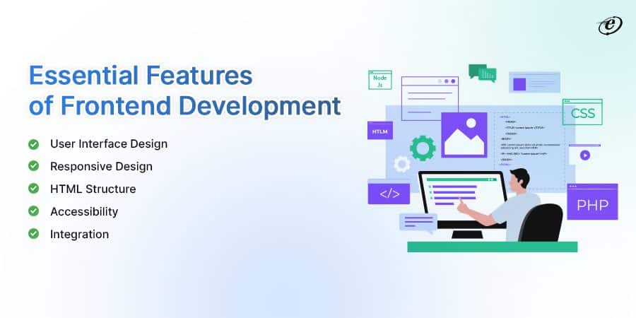
Definition of Frontend
Frontend refers to the part of web development that involves designing and creating the UI & UX of a website or application.
It encompasses the visual elements, layout, and interactive components that users directly interact with.
It is the part of the website which is visible to us.

Slide 49
Feature | Explanation
User Interface Design | Frontend developers design visually appealing and intuitive layouts, ensuring a positive user experience through well-organized content, navigation, and interactive elements.
Responsive Design | Frontend makes applications adaptable to various screen sizes and devices, ensuring consistent performance and usability across desktops, tablets, and mobile phones.
HTML Structure | HyperText Markup Language (HTML) forms the structural foundation of web content, defining headings, paragraphs, lists, and other elements to present information logically.
Accessibility | Implementing accessible design practices ensures that web content is usable by individuals with disabilities, adhering to web accessibility guidelines and standards.
Integration | Frontend components often integrate with backend systems through APIs (Application Programming Interfaces) to fetch and display dynamic data, enhancing the application’s functionality.

Slide 50
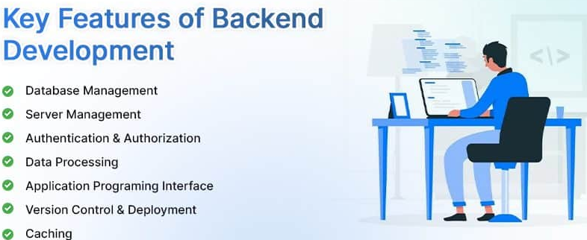
What is Backend?
Backend refers to the technical foundation of a software application or website that operates behind the scenes.
The code that enables an application or software to run and cannot be viewed by a user is known as the back end.
The backend of a computer system is where most data and operating syntax are kept and accessed.

Slide 51
Feature | Explanation
Database Management | Backend developers design and manage databases where application data is stored. This involves creating efficient data schemas, optimizing queries, and ensuring data integrity.
Server Management | The backend includes the management of servers responsible for hosting the application and handling incoming user requests.
Authentication and Authorization | Security is a fundamental concern for backend development. Backend systems manage user authentication (verifying user identities) and authorization (determining what actions users can perform).
Data Processing | Backend components process data from various sources. This could involve analyzing user inputs, performing calculations, aggregating data, and generating reports.
API (Application Programming Interface) | Backend developers design APIs that enable the frontend and external services to interact with the application’s data and functionality.
Version Control and Deployment | Backend developers use version control systems (e.g., Git) to manage code changes and collaborate effectively.
Caching | Caching involves storing frequently accessed data in a faster storage medium (like memory) to reduce the need to retrieve it from slower storage (like a database).

Slide 52
Frontend vs. Backend Development: Quick Comparison
Aspect | Frontend Development | Backend Development
Focus | User interface and user experience. | Server-side logic, data processing, and storage.
Independency | Cannot work without backend support | Work independently of the frontend
Responsibilities | Designing, styling, and interactivity of UI. | Handling server requests, data storage, and security.
Skills Required | HTML, CSS, SASS, and JavaScript | Python, Ruby, Java, and PHP
User Interaction | Direct interaction with users. | Indirect interaction via APIs and data exchange.
Performance | User interface responsiveness and smooth interactions. | Server performance, response times, scalability
Browser Compatibility | Ensuring compatibility across various browsers. | Browser-independent APIs ensure compatibility.
Data Handling | Limited data processing and validation. | Complex data processing, database interactions.
Security | Limited user interaction, some input validation. | Authentication, data encryption, access control.
Example | Displaying a dynamic news feed on a social media app. | Processing and storing user registration data.

Slide 53
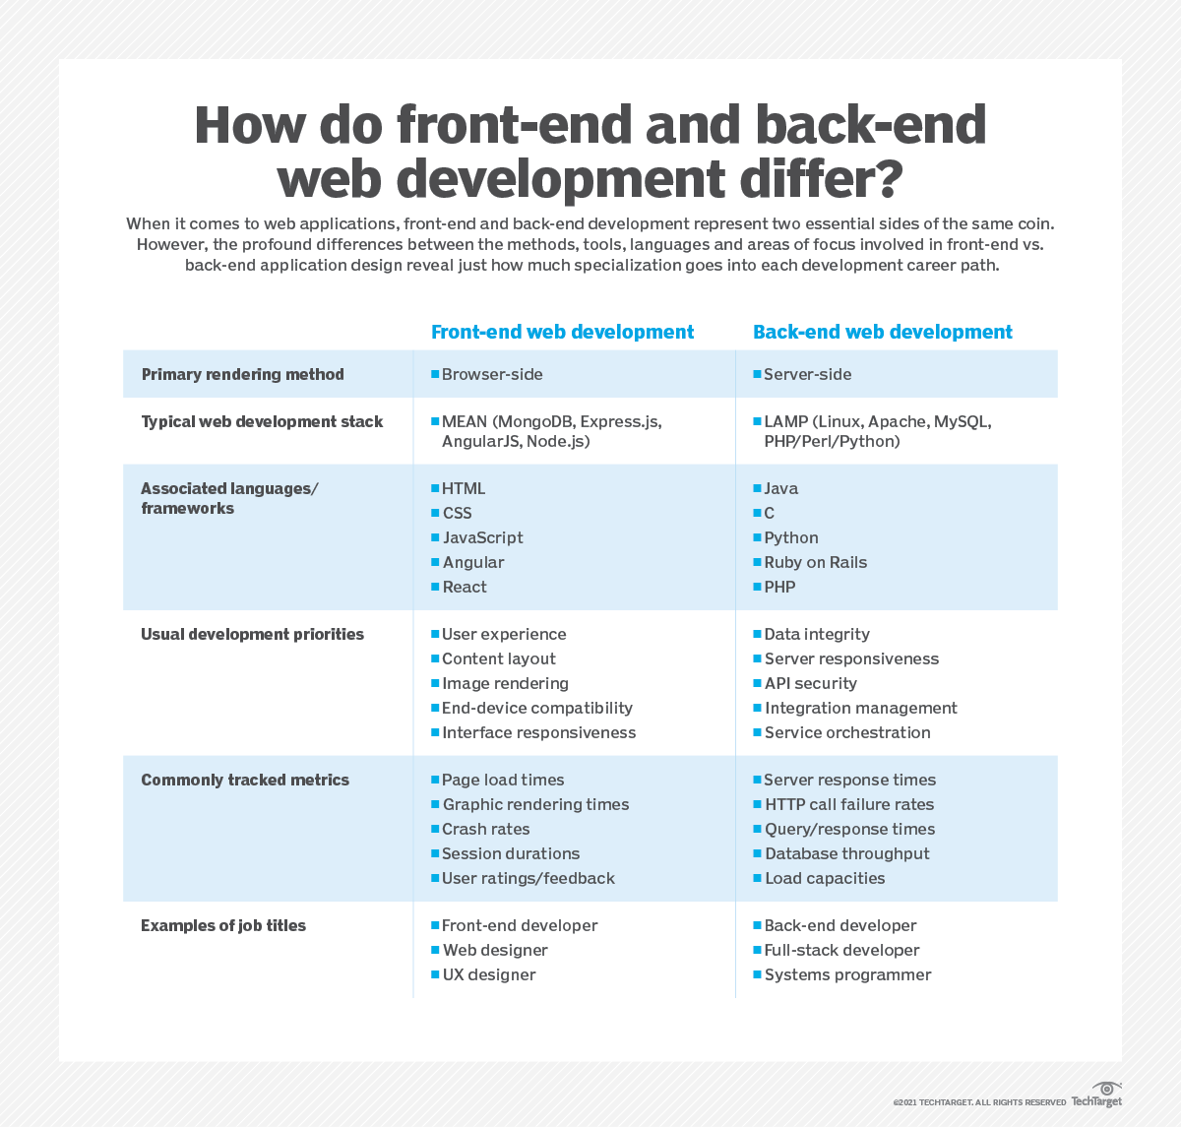

Slide 54
Frontend vs. Backend vs. Full stack Development
Parameter | Frontend Development | Backend Development | Fullstack Development
Responsibilities | UI/UX design, user interaction | Server logic, databases, APIs | Both frontend and backend development
User Experience | Focuses on visual presentation | Influences app performance | Balances user interface and functionality
Scope | User interface and design | Database management, data processing | Complete app development lifecycle
Skills Requirement | HTML/CSS/JS proficiency | Backend programming expertise | Proficiency in both frontend and backend
Interaction | Direct interaction with users | Indirect interactions through server | Manages user interactions and server logic
Technologies | HTML, CSS, JavaScript | Python, Java, PHP, databases | Combination of frontend and backend tools

Slide 55
A Full Stack Product Engineer is a professional who possesses expertise in both frontend and backend development, allowing them to work on all layers of a software application. This includes designing, implementing, and maintaining both the user interface and the server-side components. Here are the key aspects of a Full Stack Product Engineer's role:
Frontend Development:
User Interface (UI): They are proficient in building responsive and user-friendly interfaces using technologies like HTML, CSS, and JavaScript.
Client-Side Frameworks: They may be skilled in using frontend frameworks and libraries such as React.js, Angular, or Vue.js to create dynamic and interactive user interfaces.
Backend Development:
Server-Side Logic: They are experienced in developing server-side logic, handling databases, and implementing business logic. Common backend technologies include Node.js, Python (Django, Flask), Ruby on Rails, Java (Spring Boot), or ASP.NET Core.
Database Management: They are familiar with working with databases, both relational (like MySQL, PostgreSQL) and NoSQL (like MongoDB), and can design efficient database structures.
API Development:
RESTful APIs: They can design and implement RESTful APIs for communication between the frontend and backend components, ensuring efficient data transfer and interaction.
Product Development:
Full Product Lifecycle: They are involved in all stages of the product development lifecycle, from understanding requirements and designing solutions to implementing features and maintaining the product.

Slide 56
User Experience (UX): They may be involved in improving the overall user experience by collaborating with UX/UI designers and implementing design principles.
DevOps and Deployment:
Deployment and Hosting: They are knowledgeable about deployment processes and may use tools like Docker, Kubernetes, or cloud services (AWS, Azure, Google Cloud) to deploy and host applications.
Continuous Integration/Continuous Deployment (CI/CD): They may implement CI/CD pipelines to automate testing and deployment processes.
Version Control:
Git: Proficiency in using version control systems, especially Git, to manage and track changes in the codebase.
Collaboration and Communication:
Team Collaboration: Full Stack Product Engineers often work in cross-functional teams, collaborating with designers, product managers, and other developers to deliver a cohesive product.
Communication Skills: Effective communication skills are crucial for understanding project requirements, providing updates, and collaborating with team members.
Problem-Solving and Critical Thinking:
Analytical Skills: The ability to analyze and solve complex problems, whether they involve frontend user experience challenges or backend data processing issues.
In summary, a Full Stack Product Engineer is a versatile professional capable of contributing to all aspects of software development, from the user interface to the server-side logic and everything in between. Their role is crucial in creating end-to-end solutions that meet both user needs and business requirements.

Slide 57
Core Java Important Topics for your reference:
Java Syntax
Data Types
Variables
Operators
Expressions
Control Flow Statements (if, switch, loops)
Arrays
Object-Oriented Programming (OOP) - Classes, Objects, Inheritance, Polymorphism, Encapsulation and Abstraction
Abstract Classes and Interfaces
Exception Handling (try, catch, finally) and Errors
File Input/Output
Java Streams
Collections Framework - List, Set, Map, and its implementations
Generics
Multithreading, Synchronization
String Handling
Wrapper Classes
Enums
Java Date and Time
Annotations
Lambda Expressions
Core Java
Core Java refers to the fundamental and essential parts of the Java programming language that form the building blocks of Java development.
Concepts: Includes the basic principles of object-oriented programming (OOP), such as classes, objects, inheritance, encapsulation, polymorphism, etc.
Syntax: Understanding the basic syntax, data types, control structures, loops, etc.
Libraries: Utilizes core libraries, mainly those within java.lang, java.util, and similar basic packages.
JVM Understanding: Understanding how Java code is compiled into bytecode, and how it runs on the Java Virtual Machine (JVM).
Usage: Suitable for building fundamental applications and forms the base for all Java development.

Slide 58
Advanced Java Important Topics for your reference:
JDBC
Servlets
JavaServer Pages (JSP)
JavaServer Faces (JSF)
Spring (Core, MVC, Boot)
Hibernate
Networking
Remote Method Invocation (RMI)
Enterprise Java (Java EE)
Enterprise JavaBeans (EJB)
Java Persistence API (JPA)
Java Transaction API (JTA)
Java Message Service (JMS)
Design Patterns
JUnit
Mockito
Web Services (SOAP, REST)
JavaFX for GUI
Advanced Java builds on the principles of Core Java and introduces more complex and specialized concepts.
Web Development: Includes technologies for web development, like Servlets, Java Server Pages (JSP), and frameworks like Spring.
Enterprise Development: Understanding Java Enterprise Edition (JEE) with components like Enterprise JavaBeans (EJB). In Java development, most companies use Spring Framework to build enterprise applications. Spring Framework is a replacement for EJB.
Networking: Understanding sockets, RMI, and other network-related programming.
Concurrency: In-depth understanding of multi-threading, synchronization, and concurrent collections.
Design Patterns: Introduction to more complex design patterns and architecture.
Usage: Suitable for building robust, scalable, and complex applications, including web applications, distributed systems, etc.

Slide 59
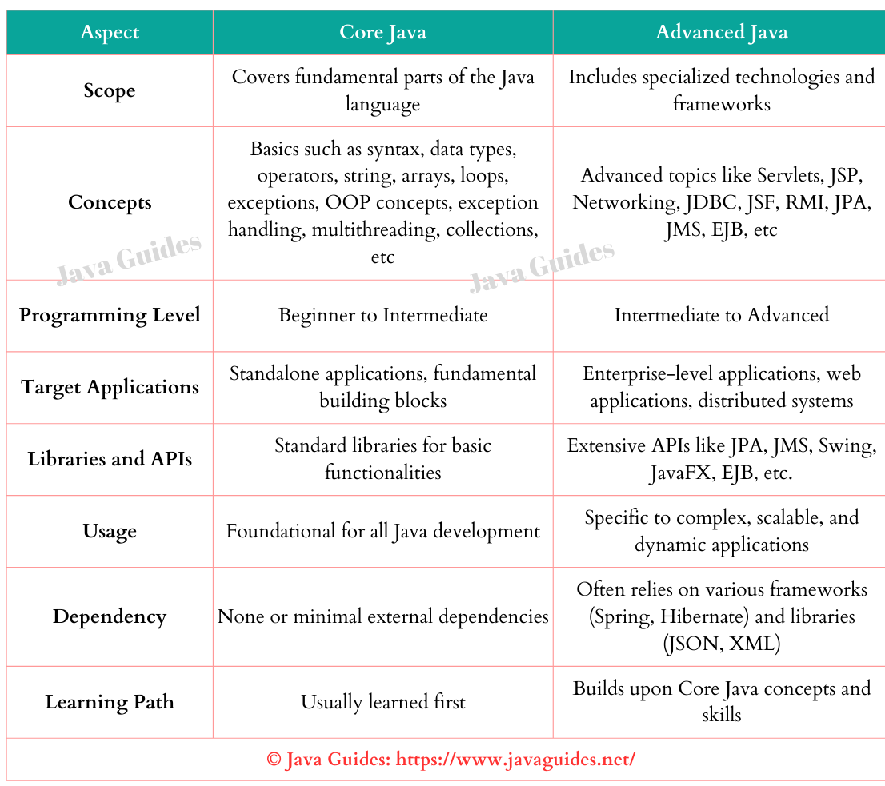

Slide 60
Aspect | Core Java | Advanced Java
Scope | Covers fundamental parts of the Java language | Includes specialized technologies and frameworks
Concepts | Basics such as syntax, data types, operators, string, arrays, loops, exceptions, OOP concepts, exception handling, multithreading, collections, etc | Advanced topics like Servlets, JSP, Networking, JDBC, JSF, RMI, JPA, JMS, EJB, etc
Programming Level | Beginner to Intermediate | Intermediate to Advanced
Target Applications | Standalone applications, fundamental building blocks | Enterprise-level applications, web applications, distributed systems
Libraries and APIs | Standard libraries for basic functionalities | Extensive APIs like JPA, JMS, Swing, JavaFX, EJB, etc.
Usage | Foundational for all Java development | Specific to complex, scalable, and dynamic applications
Dependency | None or minimal external dependencies | Often relies on various frameworks (Spring, Hibernate) and libraries (JSON, XML)
Learning Path | Usually learned first | Builds upon Core Java concepts and skills

